Slide 1

Supply Chain Management
by Yashoda Singh

Slide 2

Problem Statement
An FMCG company's instant noodle business has an inventory cost loss due to a mismatch between high demand and low supply, and vice versa. The higher management want to optimize supply quantity in every warehouse in the entire country.

Slide 3
Goal & Objectives
This exercise aims to build a model, using historical data that will determine the optimum weight of the product to be shipped each time to the warehouse.
Also, try to analyze the demand pattern in different pockets of the country so management can drive the advertisement campaign, particularly in those pockets.

Slide 4

Explore and Understand the Data:
Explore the dataset to gain insights into the characteristics of the data using data.info(). This method prints a summary that includes:
The total number of entries (rows).
The number of non-null values for each column.
The data type of each column.
The memory usage
This information is useful for identifying potential data quality issues such as missing values and understanding the overall structure of the dataset.
We can further explore specific aspects of the data, such as descriptive statistics (data.describe()), unique values in categorical columns, value counts in each column and more.

Slide 5
Data Preprocessing
Data preprocessing is a crucial step in preparing your data for machine learning models.
It involves cleaning and transforming the raw data into a format suitable for training and evaluating models.
Here are common data preprocessing steps:
Handling Missing Values:
Identify columns with missing values.
Decide on an approach to handle missing data:
Imputation: Fill missing values with the mean, median, or mode.
Removal: Remove rows or columns with missing values.

Slide 6
Data Preprocessing
Handling Outliers:
Handling outliers is an important step in the data preprocessing
process.
Outliers can significantly impact the performance of machine learning models, and addressing them appropriately is crucial.
Here are several common approaches to handle outliers:
Identification and Visualization: We can use descriptive statistics and
box plot to identify outliers visually.
Interquartile Range (IQR): IQR approach works on Interquartile Range.
It has two approaches:

Slide 7
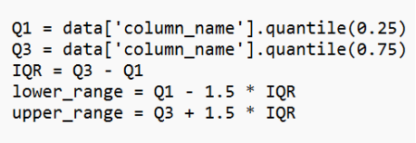
Data Preprocessing
Interquartile Range (IQR): IQR approach works on Interquartile Range. It has two approaches:
Capping Approach : data['column_name'] = np.where(data['column_name'] > upper_bound, upper_bound, data['column_name']) data['column_name'] = np.where(data['column_name'] < lower_bound, lower_bound, data['column_name'])
Trimming Approach : data_no_outliers = data[~((data['column_name'] < (Q1 - 1.5 IQR)) | (data['column_name'] > (Q3 + 1.5 IQR)))]
Z-Score or Standard Score: Calculate the z-score for each data point and set a threshold to identify outliers. Common threshold values are ±2 or ±3 standard deviations.

Slide 8
Data Preprocessing
Encoding Categorical Variables:
Convert categorical variables into a numerical format.
Label encoding involves assigning a unique numerical label to each category in a categorical variable. This is typically done in alphabetical order.
But this assignment of unique numerical label could introduce unintended ordinal relationships.
Mapping is a manual approach where you define a dictionary to map each category to a specific numerical value. This is helpful for ordinal type of data.
One-hot encoding is common for nominal categories.
One-hot encoding is a technique used to convert categorical variables into a binary matrix, where each unique category becomes a column with binary values (1 or 0). This approach is particularly useful when dealing with categorical variables with multiple categories and no inherent ordinal relationship between them.

Slide 9
Data Preprocessing
Scaling data: Scaling is a preprocessing step that is often necessary before applying certain machine learning algorithms, especially those that are sensitive to the scale of input features.
Three common scaling techniques are:
StandardScaler
MinMaxScaler
RobustScaler
Split the dataset into training and testing sets. The training set is used to train the model, while the testing set is used to evaluate its performance.

Slide 10
Feature Selection:
Performing feature selection using RandomForestRegressor.
Train RandomForestRegressor:
Initialize and train a RandomForestRegressor model using your feature matrix X and target variable y.
Retrieve Feature Importances:
Extract the feature importances from the trained model. This information is stored in the feature_importances_ attribute of the RandomForestRegressor.
Select Important Features:
Use the feature importances to select important features. In this example, SelectFromModel is used with a threshold. Features with importances above the threshold are considered important.
Transform the Data:
Transform your original feature matrix X to include only the selected important features.

Slide 11

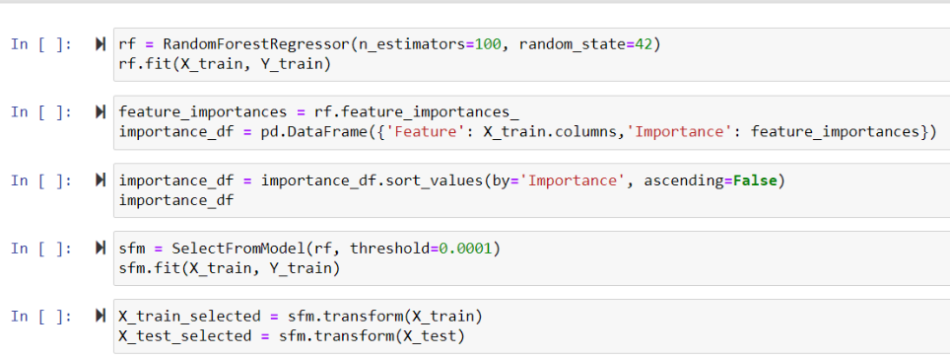
Feature Selection:

Slide 12
Regression Models
Linear regression model: The goal of linear regression is to find the best-fitting straight line that minimizes the difference between the predicted and actual values of the dependent variable.
Random Forest regression model: Random Forest Regression is an ensemble learning method that combines the predictions of multiple decision tree regressors to improve the overall predictive performance and robustness of the model.
AdaBoost: AdaBoost, short for Adaptive Boosting, is an ensemble learning method that combines the predictions of multiple weak learners (usually decision trees) to create a strong classifier. The main objective of AdaBoost is to adaptively give more weight to the misclassified data points in each iteration, focusing on the examples that are difficult to classify correctly.
GradientBoosting: Gradient Boosting is an ensemble learning method that builds a series of weak learners (typically decision trees) sequentially, with each tree correcting the errors of the previous one. The process involves minimizing a loss function by gradient descent.

Slide 13
Regression Models
XGBoost: XGBoost (Extreme Gradient Boosting) is an optimized and efficient implementation of the gradient boosting framework. XGBoost aims to minimize a regularized, convex objective function. The objective function consists of two parts: a loss term measuring the difference between predicted and true values and a regularization term controlling the complexity of the model. It builds an ensemble of weak learners sequentially. Each weak learner is a decision tree.
LGBM: LightGBM (Light Gradient Boosting Machine) is a gradient boosting framework that is designed for speed and efficiency. It's particularly effective for large datasets and high-dimensional data.
CatBoost: CatBoost (Categorical Boosting) is a gradient boosting algorithm designed to handle categorical features efficiently. CatBoost is particularly well-suited for datasets with a mix of categorical and numerical features. Its ability to handle categorical features efficiently and its strong out-of-the-box performance make it a popular choice, especially in situations where feature engineering and hyperparameter tuning efforts need to be minimized.

Slide 14
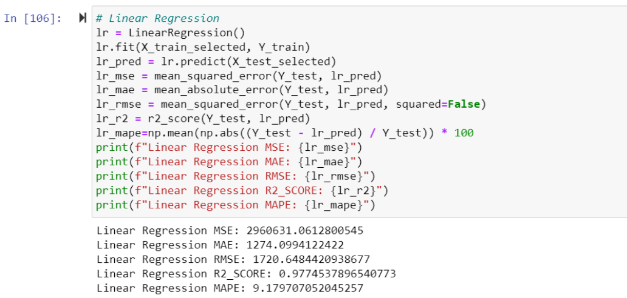
Regression Models

Slide 15

Evaluation and Analysis
Some commonly used performance metrics for regression models are:
Mean Squared Error (MSE): It measures the average squared difference between predicted and actual values. Larger errors are penalized more.
Mean Absolute Error (MAE): It measures the average absolute difference between predicted and actual values. It is less sensitive to outliers compared to MSE.
Root Mean Squared Error (RMSE): It is the square root of the MSE, providing a measure in the original units of the target variable. Like MSE, larger errors are penalized more.
R-squared (R2) Score: It measures the proportion of the variance in the target variable that is predictable from the independent variables. R2 score ranges from 0 to 1, where 1 indicates a perfect fit.
Mean Absolute Percentage Error (MAPE): It calculates the percentage difference between predicted and actual values, making it easy to interpret.

Slide 16
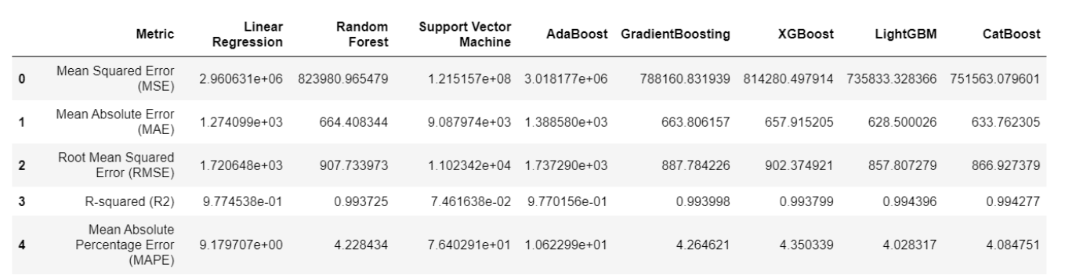
Evaluation and Analysis
Comparison table for different performance metrics of different algorithms:
CatBoost and LightGBM are giving the best results amongst all algorithms.

Slide 17
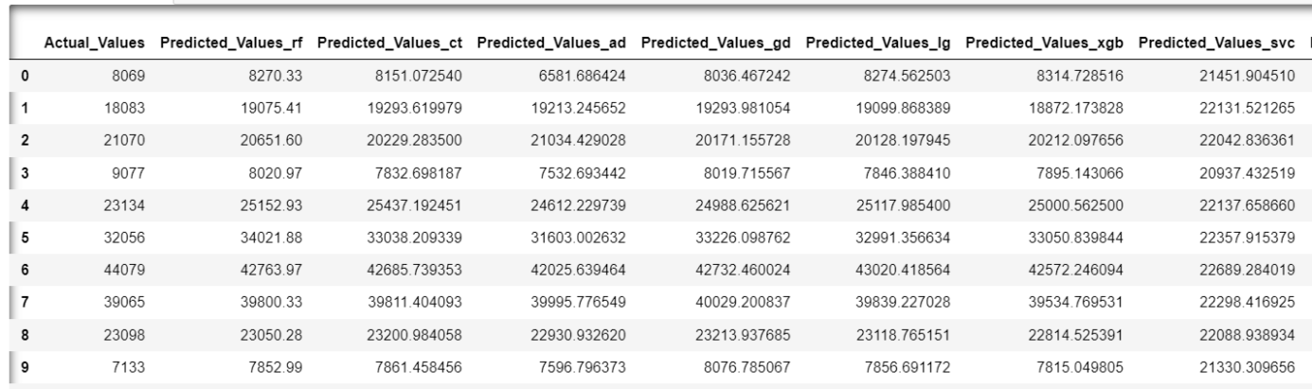
Evaluation and Analysis
Table denoting the actual value of data and the corresponding prediction values for various regression models:

Slide 18
Cross Validation:
To check if the model is overfitting we can evaluate the model using cross-validation.
Cross-validation helps assess the model's performance on different subsets of the data, providing a robust measure.
We can compare the mean squared error (MSE) scores and the average MSE given by
cross validation approach which provides insights into the performance of the model
across different folds of the dataset.
Cross-Validated MSE Scores:
Fold 1 MSE: 748,192.30
Fold 2 MSE: 736,484.57
Fold 3 MSE: 816,982.87
Fold 4 MSE: 743,932.40
Fold 5 MSE: 747,316.45
Average MSE:
Average MSE: 758,581.72
A lower MSE is desirable, indicating better model performance. The MSE values across folds are relatively close, suggesting consistency in model performance.
If the cross-validated MSE is close to the MSE of the testing set, it indicates good generalization.

Slide 19

Conclusion
The regression models, particularly using algorithms like LightGBM, Random Forest, and CatBoost, demonstrate strong predictive performance.
The average cross-validated Mean Squared Error (MSE) is around 758,581.72, indicating that the models generalize well to different subsets of the data.
The models show good generalization from training to testing data.
There is no significant overfitting, as indicated by the close resemblance of training and testing metrics.
Comparing model MSE values with a baseline model demonstrates a substantial improvement in predictive performance.
Given the models' performance, one may recommend deploying the LightGBM, Random Forest, or CatBoost model for making predictions on new, unseen data.

Slide 20
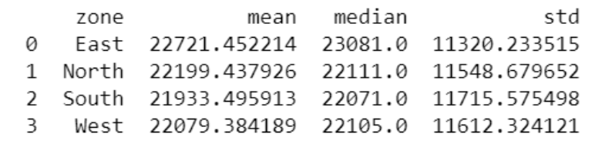
Demand Pattern Analysis
Table representing central tendency and variability for different zones based on product weight in tons (target variable):

Slide 21
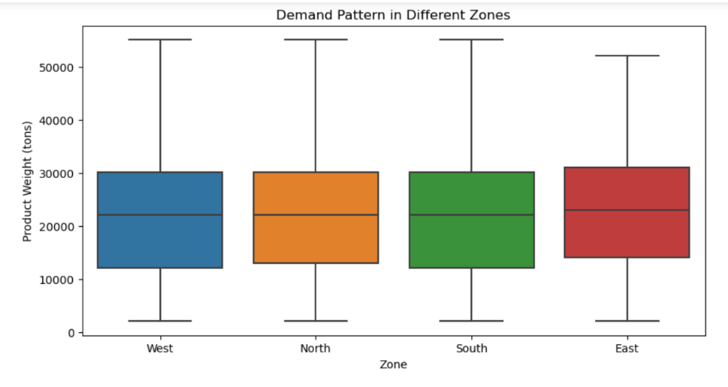
Demand Pattern Analysis

Slide 22
Conclusion
The mean and median values, along with the similar standard deviations, indicate a relatively consistent demand pattern across the zones.
There are no significant differences in the central tendency or variability in product weight, suggesting a balanced demand across the regions.

Slide 23
Thank you for your
valuable time.

